Slide 1
CYBERSECURITY INTERNSHIP
WEEK 7 ASSIGNMENT
VAPT: WEB APPLICATION TESTING WITH BURP SUITE
Submitted by
Name: Deepashree.C
Role: Cybersecurity Intern
Week: Week 7
SIN: DG/SEPTEMBER/CYBER/254
Submitted to: DG Interns Hub
Topics covered:
o Burp Suite setup & HTTP/HTTPS traffic interception
o Web application reconnaissance and attack surface mapping
o SQL Injection, XSS (Reflected & Stored),Authentication Testing
o Parameter tampering, Directory & Endpoint Discovery
o VAPT vulnerability analysis, risk assessment and remediation

Slide 2
OBJECTIVES & SCOPE
Objectives:
Configure Burp Suite as an intercepting proxy.
Intercept and analyze HTTP/HTTPS traffic from DVWA.
Identify authentication requests, session cookies, and input parameters.
Map DVWA endpoints and identify its attack surface.
Perform manual vulnerability testing using Burp Repeater.
Test for SQL Injection, Cross-Site Scripting (XSS), and parameter tampering.
Document at least three vulnerabilities with impact and remediation.
Scope:
Target: DVWA hosted in a controlled local laboratory.
Testing Areas: Authentication, input validation, SQL Injection, XSS, session handling, and endpoint discovery.
Testing Restriction: All testing was performed only against the authorized educational lab application.

Slide 3
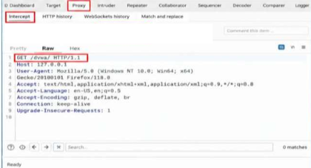
BURP SUITE SETUP & INTERCEPTION
Burp Suite Setup and Configuration:
Burp Suite was configured as an interception proxy.
Firefox was configured to use proxy host 127.0.0.1 and port 8080.
Proxy interception was enabled to capture browser requests.
Burp's CA certificate was installed in Firefox for HTTPS traffic analysis.
Intercepted Request:
GET /dvwa/ HTTP/1.1
Host: 127.0.0.1
User-Agent: Mozilla/5.0
Key Observation:
Burp Suite successfully intercepted and analyzed HTTP requests from Firefox before forwarding them to the local DVWA application.
Figure: HTTP Request Intercepted Using Burp Suite Proxy

Slide 4
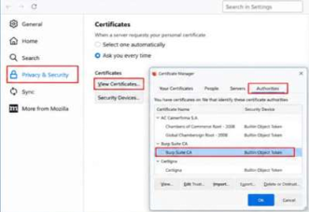
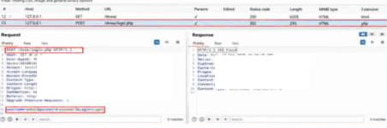
HTTPS CERTIFICATE & LOGIN REQUEST
HTTPS Interception and Login Request Analysis:
HTTPS Interception:
Burp Suite's CA certificate was installed in Firefox to inspect HTTPS traffic within the authorized lab.
HTTPS requests and responses were captured and examined using Burp Suite.
Login Request Analysis:
The DVWA login request was intercepted and analyzed.
The request was examined for its HTTP method, login endpoint, username and password parameters, headers, response status, and session cookie.
Key Observation:
The captured login exchange provided insight into how DVWA processes authentication requests and manages session cookies after a successful login.
Fig: Burp Suite CA Certificate Installed in Firefox
Fig: DVWA Login Request Captured Through Burp Suite

Slide 5
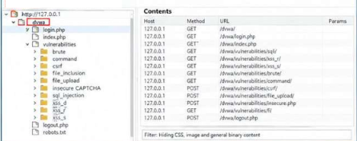
RECONNAISSANCE & APPLICATION MAPPING
Application Reconnaissance and Mapping
Burp Suite Proxy and Target Site map were used to explore the DVWA application.
The following components were identified:
  Login and logout pages.
  Vulnerability modules and input fields.
  GET and POST parameters.
  Application directories and static resources.
  Accessible application endpoints.
Example Parameters:
GET: id=1
POST: username=admin, password=password
Key Observation:
Application mapping helped identify accessible resources, user-input points, and potential areas for further vulnerability assessment.
Figure: DVWA Application Attack Surface Mapped in Burp Suite

Slide 6
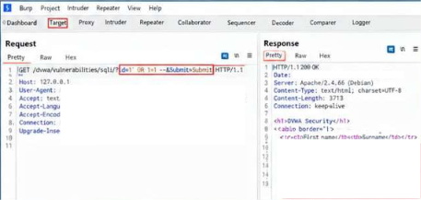
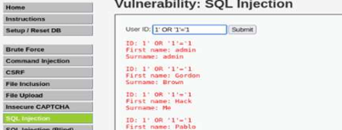
SQL INJECTION TESTING
SQL Injection Vulnerability Assessment
Testing Approach
Opened the DVWA SQL Injection module and submitted a valid input.
Intercepted the request using Burp Suite Proxy and forwarded it to Repeater.
Modified the input parameter with an SQL Injection test string.
Compared the server responses to determine whether the input affected the database query.
Test Payload:
' OR 1=1--
Impact:
SQL Injection may expose database information or enable unauthorized data access and modification, depending on the application's configuration.
Remediation:
Use parameterized queries and prepared statements.
Apply server-side input validation.
Restrict database permissions according to least privilege.
Key Observation:
Differences in the application response helped assess whether user input was improperly incorporated into SQL queries.
Fig: SQL Injection Payload in Burp Repeater
Fig: SQL Injection Response Demonstrating Multiple Records

Slide 7
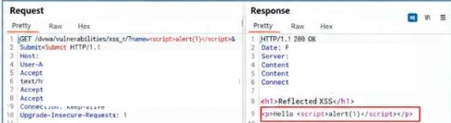
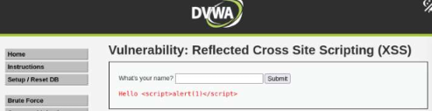
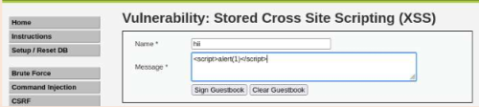
CROSS-SITE SCRIPTING TESTING
XSS Testing
Tested DVWA Reflected and Stored XSS modules using Burp Suite.
Modified input parameters in Repeater and submitted a proof-of-concept payload.
Checked whether the input was reflected or stored and executed unsafely.
Test Payload:
<script>alert(1)</script>
Remediation:
Apply output encoding, validate input, and implement Content Security Policy (CSP).
Key Observation:
Testing helped identify whether user input could execute as JavaScript in the browser.
Figure : Reflected XSS Payload Submitted Through Burp Repeater
Figure: Reflected XSS Successfully Executed in DVWA
Figure: Stored XSS Executed After Retrieval

Slide 8
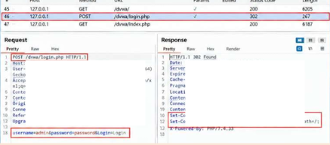
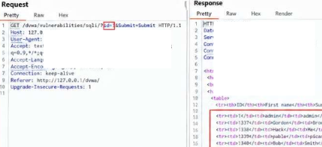
AUTHENTICATION & PARAMETER TAMPERING
Authorization Testing
Testing Method: Authorization was tested using Burp Suite HTTP History and Repeater to check access to restricted resources.
Areas Examined
Protected URLs
User roles and privileges
Unauthorized access
Server response
Testing Process
Capture an authenticated request.
Send it to Burp Repeater.
Modify the request or use a lower-privileged test account.
Send the request and compare responses.
Verify whether access is properly restricted.
Security Principle: The server must verify user permissions before allowing access to protected resources.
Fig: Authentication Request and Session Cookie Analysis
Fig: Parameter Value Modified Using Burp Repeater

Slide 9
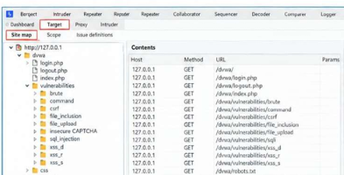
DIRECTORY & ENDPOINT DISCOVERY
Session Management Testing
Testing Method: Burp Suite HTTP History was used to examine session cookies and logout behavior.
Areas Examined
Session cookie
Cookie attributes
Session expiration
Logout behavior
Testing Process
Capture the login request.
Identify the session cookie.
Examine its attributes.
Log out and replay a previous authenticated request.
Verify whether the session is invalidated.
Security Importance: Proper session management prevents unauthorized access through stolen, expired, or invalid session cookies.
Figure: Directory and Endpoint Discovery of the Local DVWA Application

Slide 10
VAPT FINDINGS AND REMEDIATION
VAPT Findings
Finding | Testing Method | Recommended Remediation
SQL Injection | Burp Repeater | Use parameterized queries
Reflected XSS | Burp Repeater + Browser | Apply output encoding
Stored XSS | Burp + Browser | Sanitize input and encode output
Authentication/Session Issues | HTTP History | Secure authentication and session handling
Parameter Tampering | Burp Repeater | Enforce server-side validation and authorization
Endpoint Discovery | Target/Site Map | Restrict access to sensitive resources

Slide 11
CONCLUSION
The testing demonstrated how client-side requests can be intercepted and analyzed using Burp Suite.
It improved understanding of the relationship between HTTP methods, parameters, headers, and server responses.
Vulnerability testing emphasized the need for secure coding practices throughout application development.
Proper authentication and authorization mechanisms help protect confidential user information.
Input validation and output encoding reduce the risk of injection attacks.
Security testing helps identify weaknesses in application configuration and access restrictions.
The assessment highlighted the importance of protecting sensitive information transmitted through HTTP requests.
Developers should follow the principle of least privilege when assigning user permissions.
Error messages should not disclose sensitive technical details about the application.
Security controls should be tested against both valid and unexpected user inputs.
Findings should be documented with their testing methods, potential impact, and remediation recommendations.
Fixing vulnerabilities and performing follow-up testing helps strengthen the application's overall security posture.
VAPT supports a proactive approach to identifying and mitigating security risks.
The exercise provided practical experience in web application security testing using an intentionally vulnerable environment.
Continuous security assessment is essential to maintaining the confidentiality, integrity, and availability of web applications.

